Slide 1


Data and mining CO2 Emissions & its relation with GDP and Population
VISHAL SHARMA (17BCS1610)
RITIK KATOCH (17BCS1629)

Slide 2
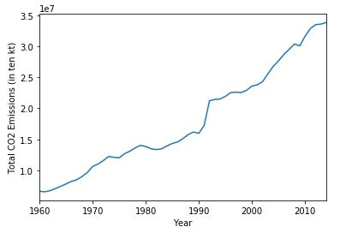
CO2 Emissions Worldwide
CO2 Emissions have increased from a mere 6.6 KT in 1960 to 38.4 KT in 2014.

Slide 3
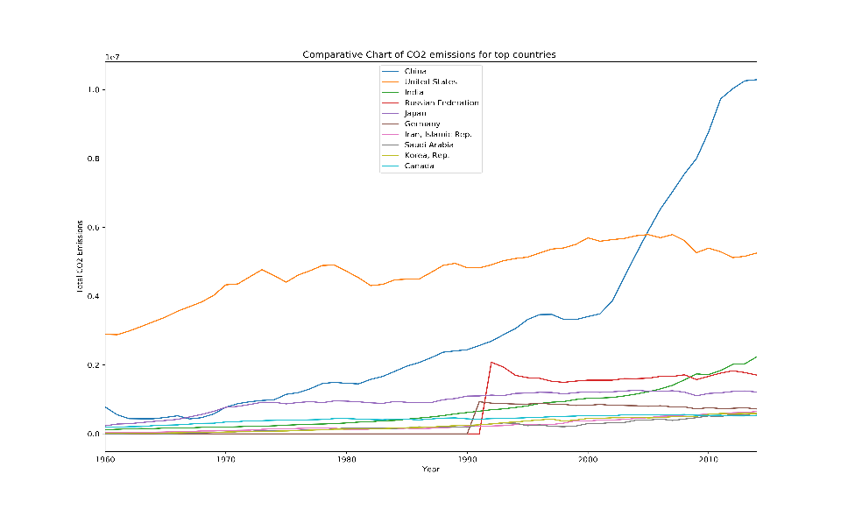
Top CO2 Emitters in the world

Slide 4
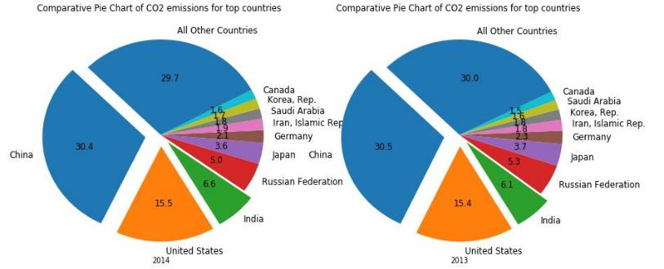
Share of countries in CO2 emissions
China USA & India produces almost half of world’s CO2 emissions.
Share of China and India is on the rise for last few years.

Slide 5







Slide 6
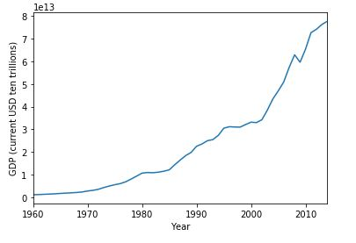

Gross Domestic Production Worldwide
World GDP has increased from 1.16 trillions in 1960 to more than 77 trillions in 2014

Slide 7
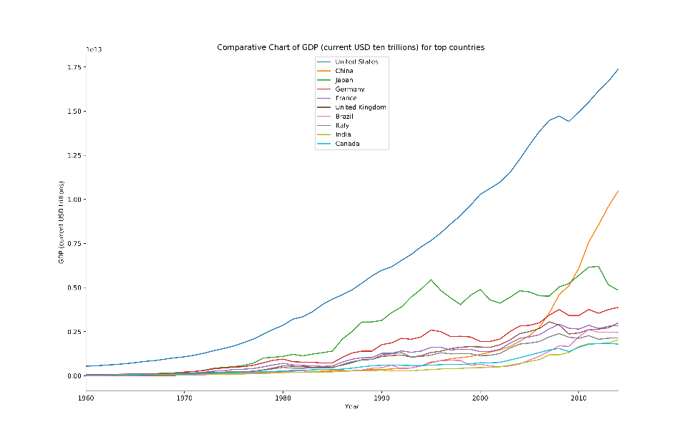
Top economies in the world
USA, China,
and Japan are the three top economies as
of 2014.

Slide 8

China shows a dramatic increase and has become world’s second largest economy beating Japan.

Slide 9
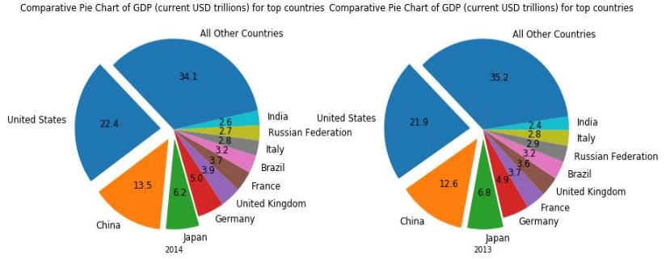
Share of countries in World GDP
US, China & Japan produces almost 40% of world’s GDP.
Share of China and India is on the rise for last few years, while for Japan it’s decreasing.

Slide 10
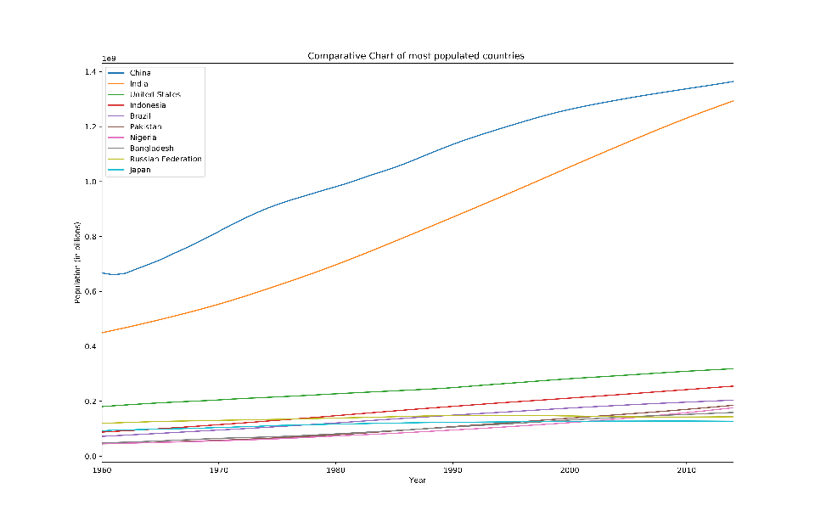
Most populated countries in the world
China, India and US are three most populated countries as
of 2014.

Slide 11
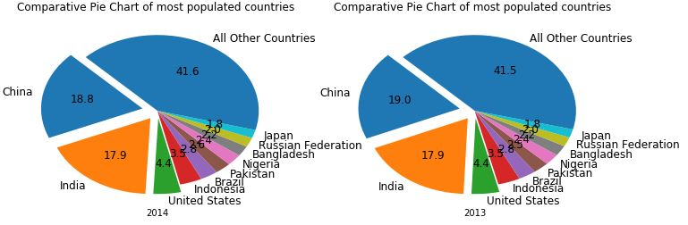
Share of countries in World Population
China, India & US houses almost 40% of world’s population.

Slide 12
CO2 Emissions and its relation with GDP & Population
CO2 Emissions shows a good trend and linear relationship with GDP. In general, wealthier economies especially those in North America, Europe and East Asia have high CO2 emissions and has grown at much higher pace after beginning of 21st century
CO2 Emissions shows a good trend and linear relationship with population. In general highly populated countries especially those in East and South Asia, North and Latin America have high CO2 emissions and it has grown significantly after 1990s.
High & Upper Middle economies are the major CO2 emitters while some lower middle & low income economies where population is high are also contributing significantly.
CO2 Emissions shows a good trend and linear relationship with GDP and population. Although less prominent as compared to GDP, but population also has effect on CO2 emissions. With the combined effect of increase in population and economic development started near the end of 20th century the upticks in CO2 emissions have been much more prominent.

Slide 13
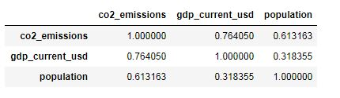
CO2 Emissions Modeling using Regression
Correlation Matrix shows that both GDP and Population are correlated to CO2 Emissions.
Linear Regression gives a test accuracy of 78%.
Random Forest Regressor improved it further to 87.5 % which again shows that CO2 Emissions can be predicted for given GDP and Population with reasonable accuracy

Slide 14
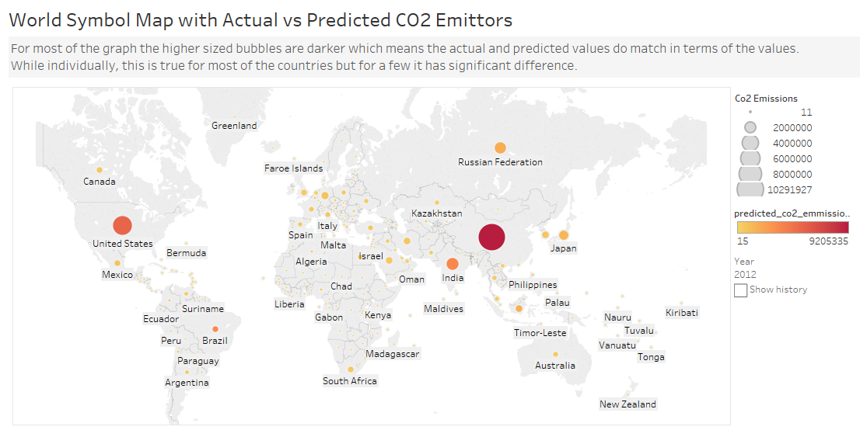
CO2 Emissions Predictions using Regression

Slide 15
Conclusions .
CO2 Emissions has shown its relation with GDP & Population
With economic growth and increase in population CO2 emissions have also grown at much higher pace since beginning of 21st century.
Economic growth has its benefits but it should not be at the cost of increased pollution. It should be sustainable as well.
With more and more people harnessing resources of the nature they must be used judiciously in order to benefit the future generations.
Countries especially those with high GDP, Income and Population should think of not only discussing the policies but also implementing them and also taking the help of people by spreading awareness among them before it’s too late.

